Slide 1
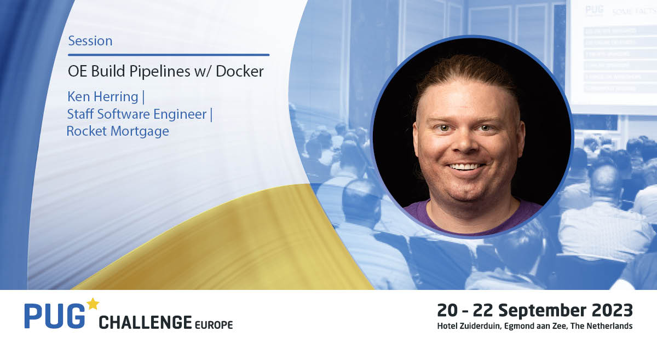

Slide 2
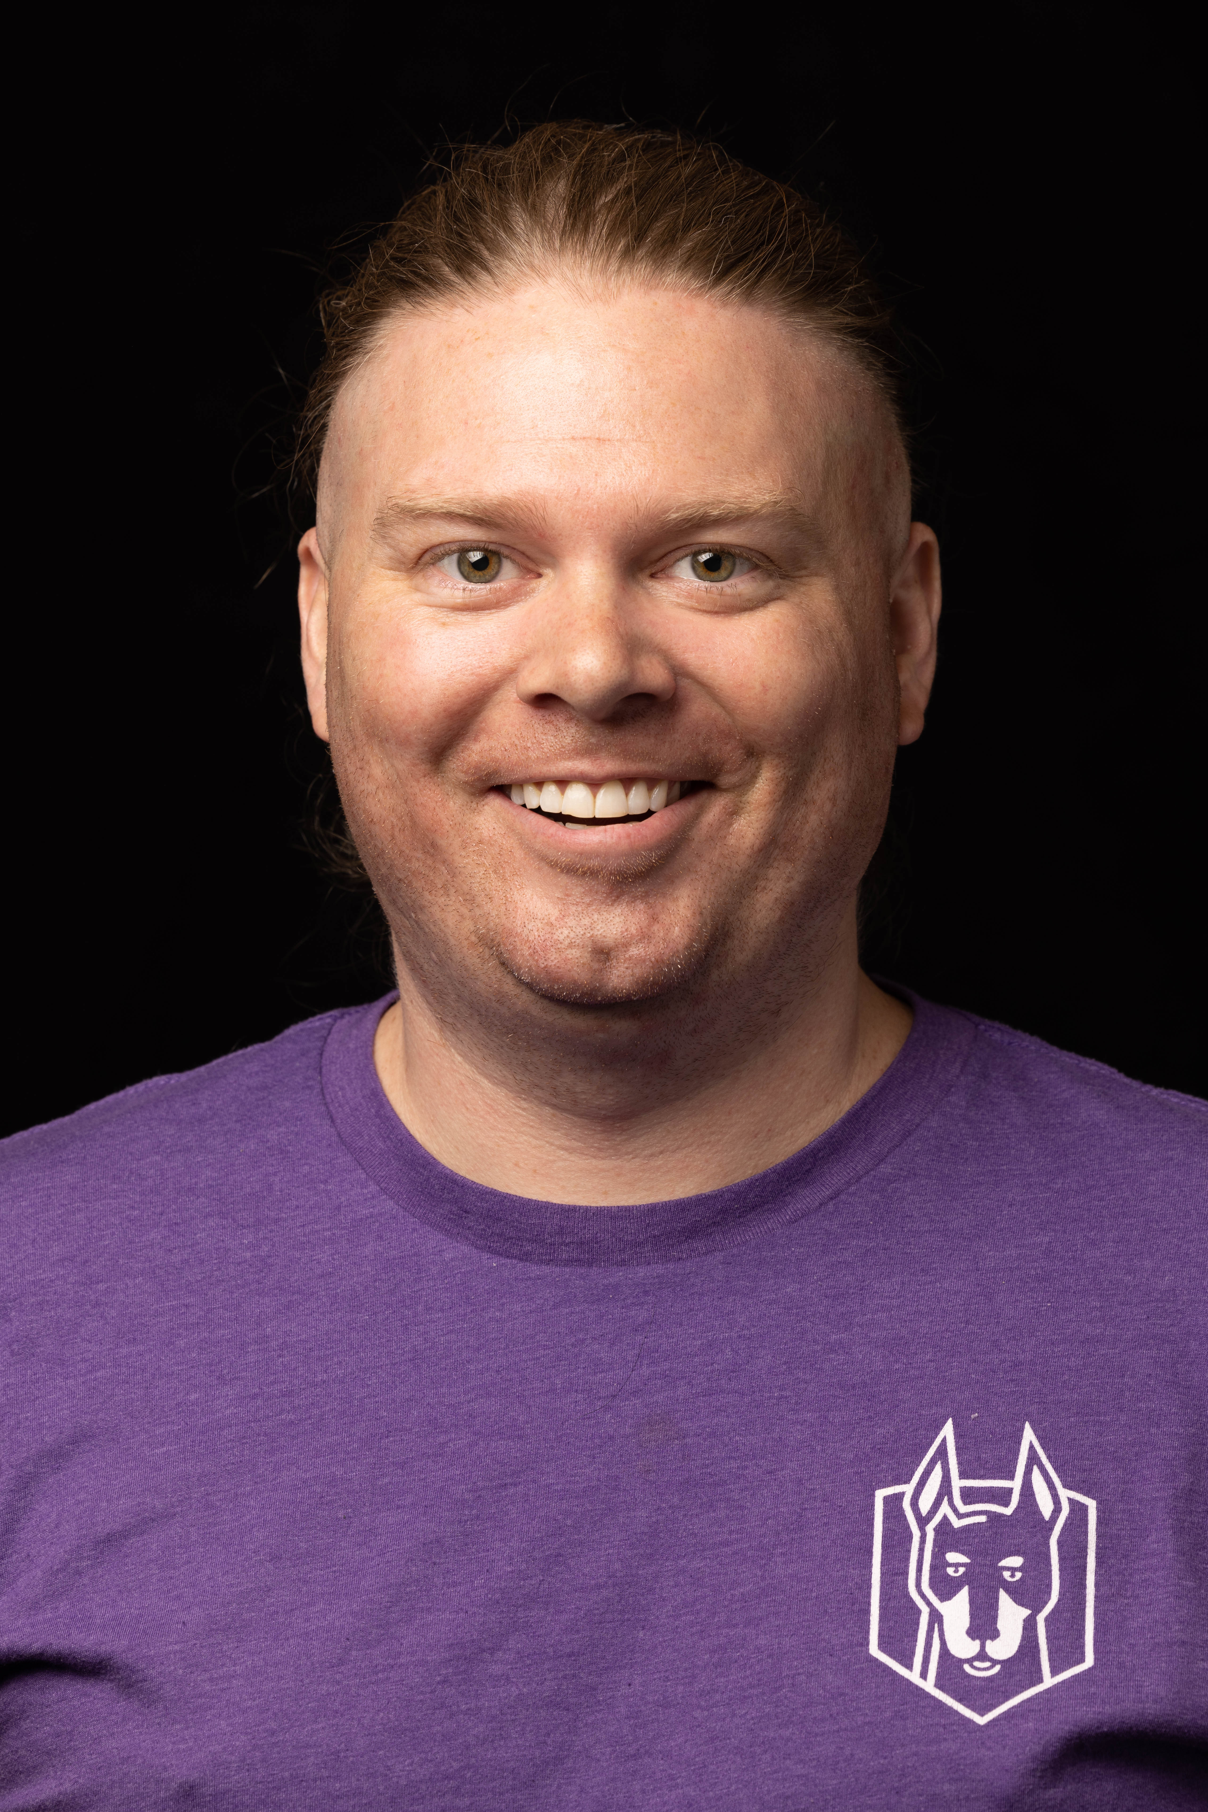

OE Build Pipelines w/ Docker
Let’s discuss how to run build pipelines for every PR that ensure we’re deploying code at the highest quality. These pipelines help us avoid frustration in code reviews by using pedantic robots instead of pedantic people. This allows reviewers to change focus from small details to the important part: what does the code do?
Presented By: Ken Herring, 2023-09-20
GitHub: @kenherring - https://github.com/kenherring
LinkedIn: https://www.linkedin.com/in/ken-herring-b55b5287/
Email: kennethherring@gmail.com

Slide 3
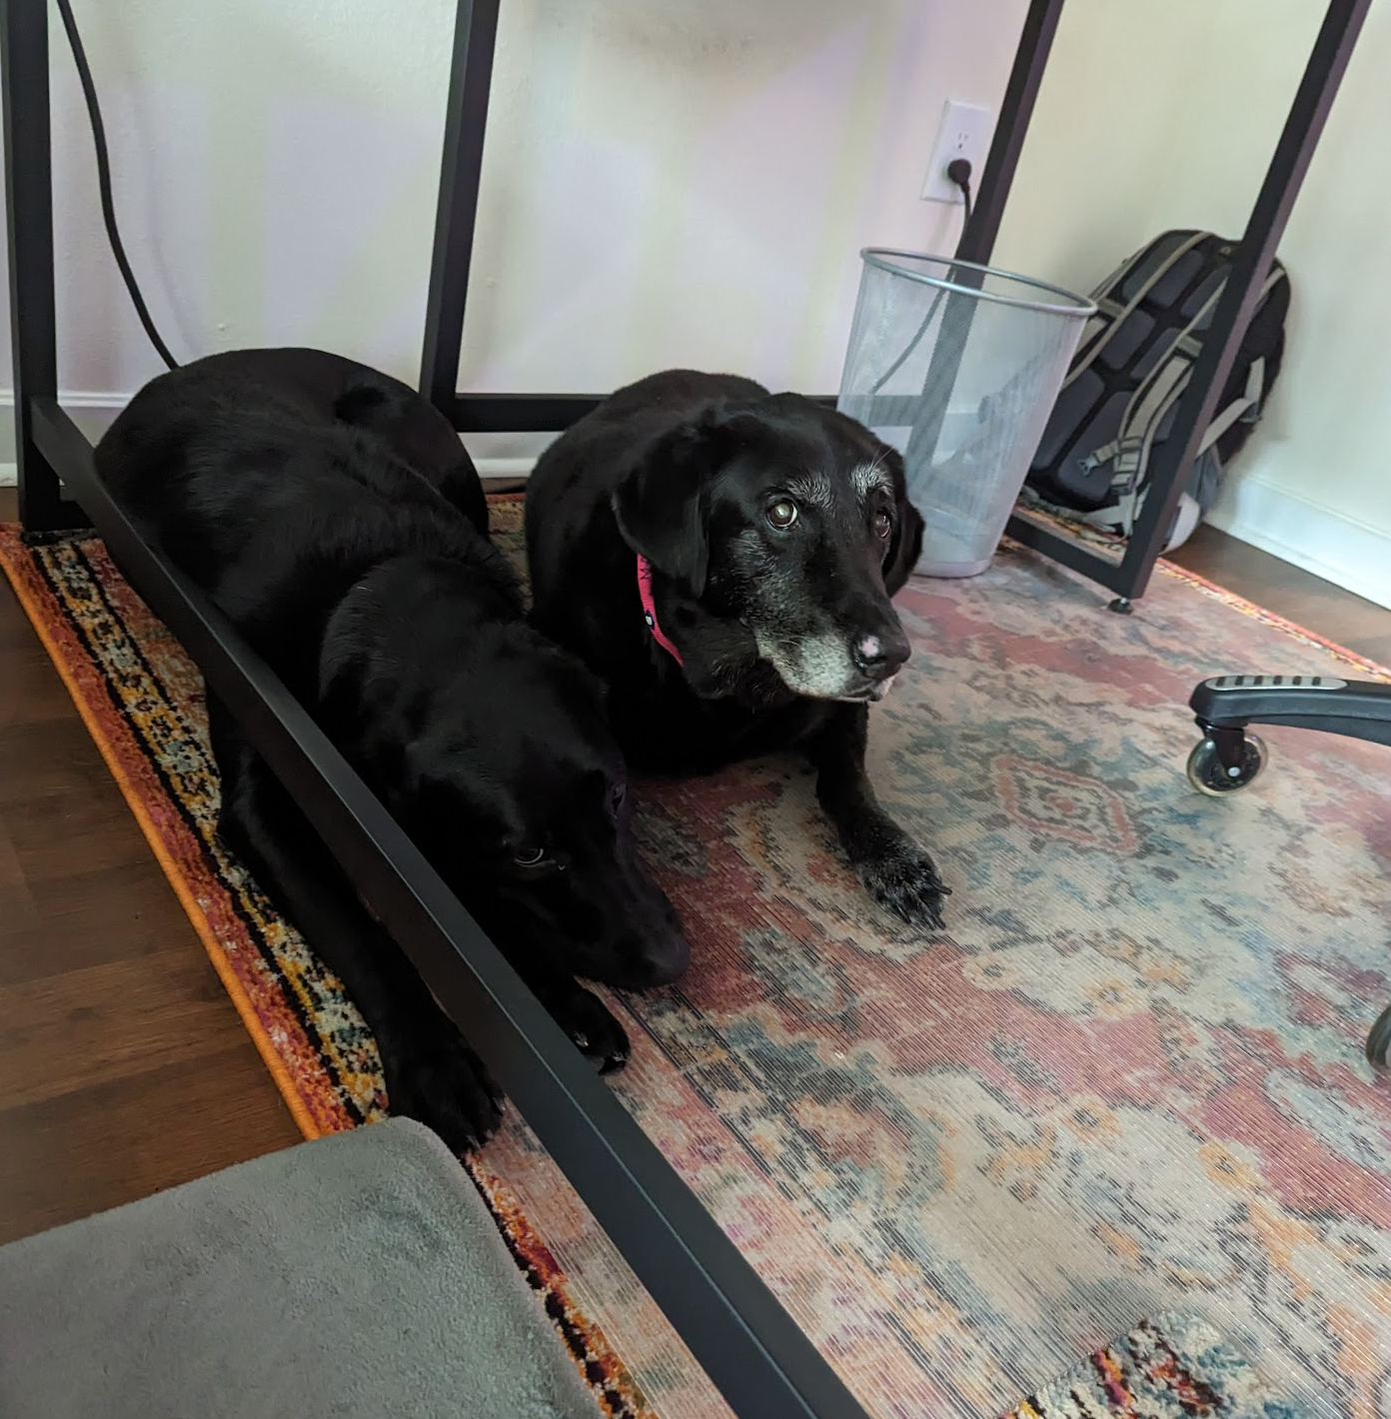
About Me
I currently live in Tampa, FL
Originally from Bethlehem, PA
I’ve been writing code my whole life, professionally since 2010
First used OpenEdge in 2010
Started my career in ERP @ Apprise Software
Currently work for Rocket Mortgage as a Staff Software Engineer
I have two dogs: Maia and Lily

Slide 4
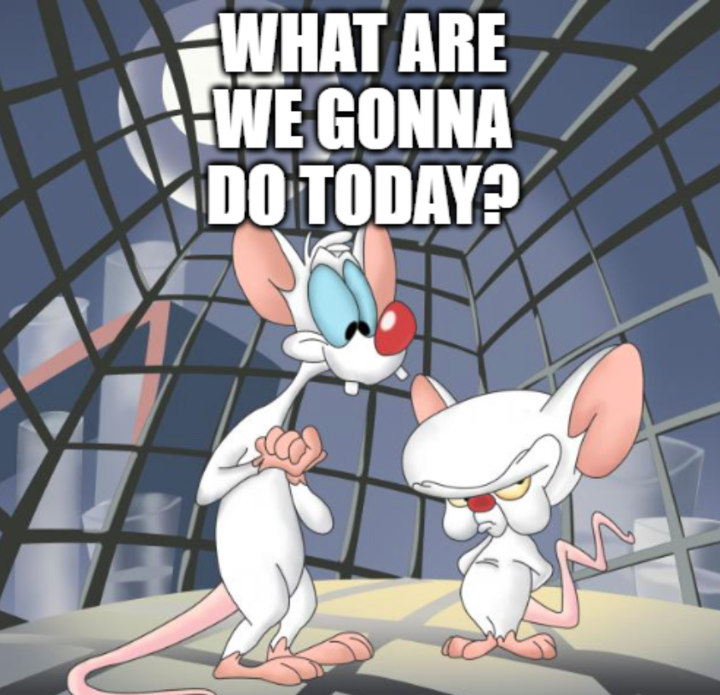
Agenda
What are we solving for?
Build Pipelines
Tooling
A day in the life…
of an OE developer w/ pipelines
Live Demo

Slide 5
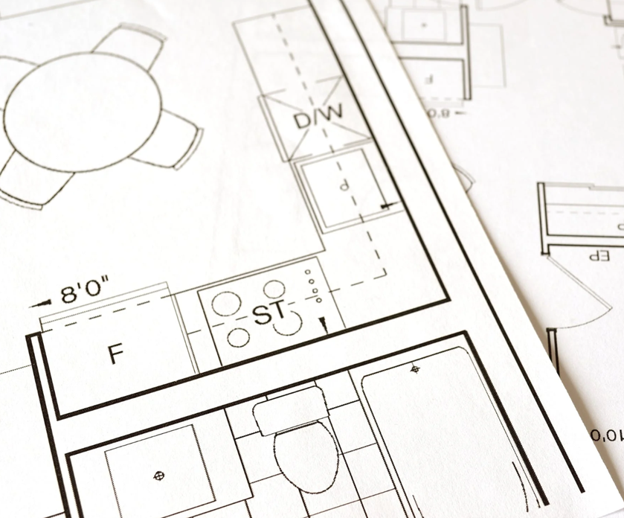
Session Expectations
Target Audience: anyone who writes code or is interested in DevOps
Takeaways:
Basic understanding of pipelines
Value proves itself
If you don’t have them already, you’ll be adding them next week!

Slide 6
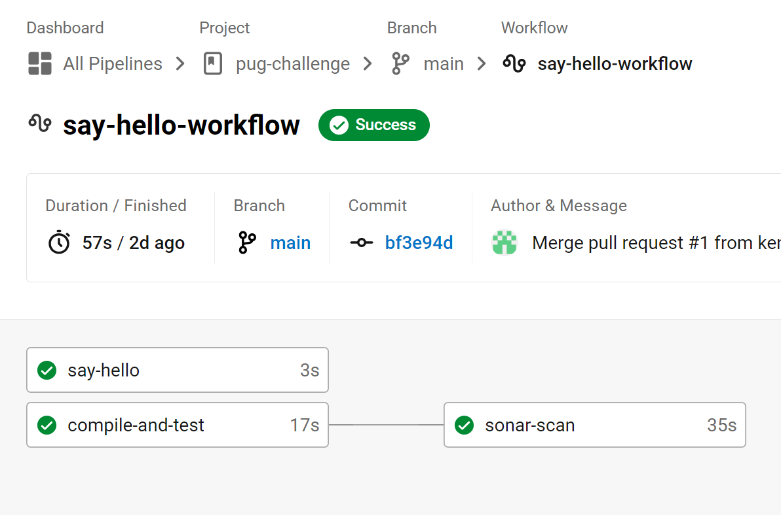
Build Pipelines – What are they?
Build piplines automate various activities, such as
Compilation
Testing
Packaging
Deployment

Slide 7
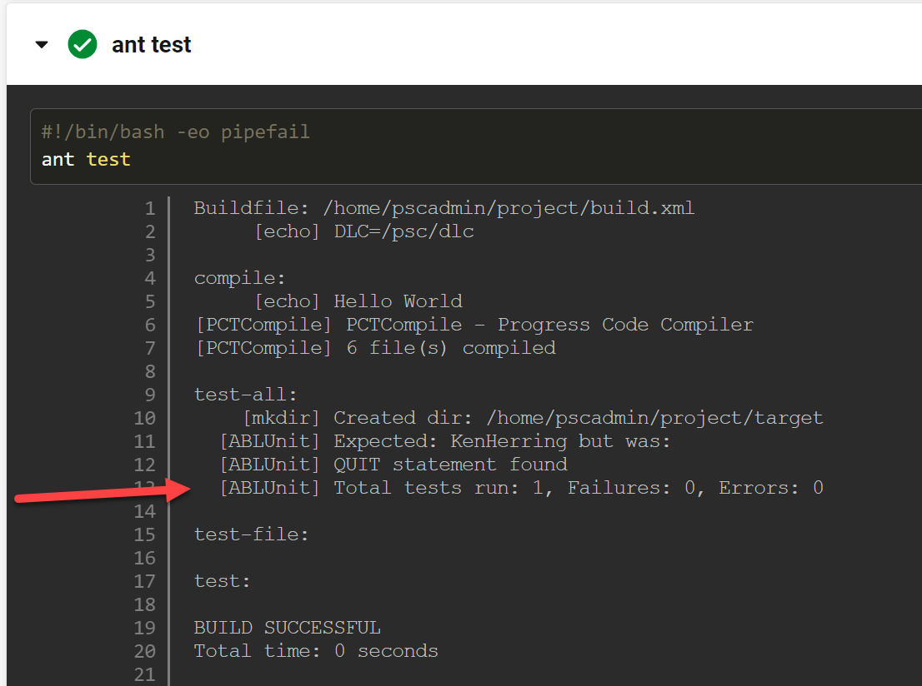
Build Pipelines – Testing
Unit Testing
Integration Testing
Performance Testing
Vulnerability Testing
Validation Testing
SonarQube / Linting

Slide 8
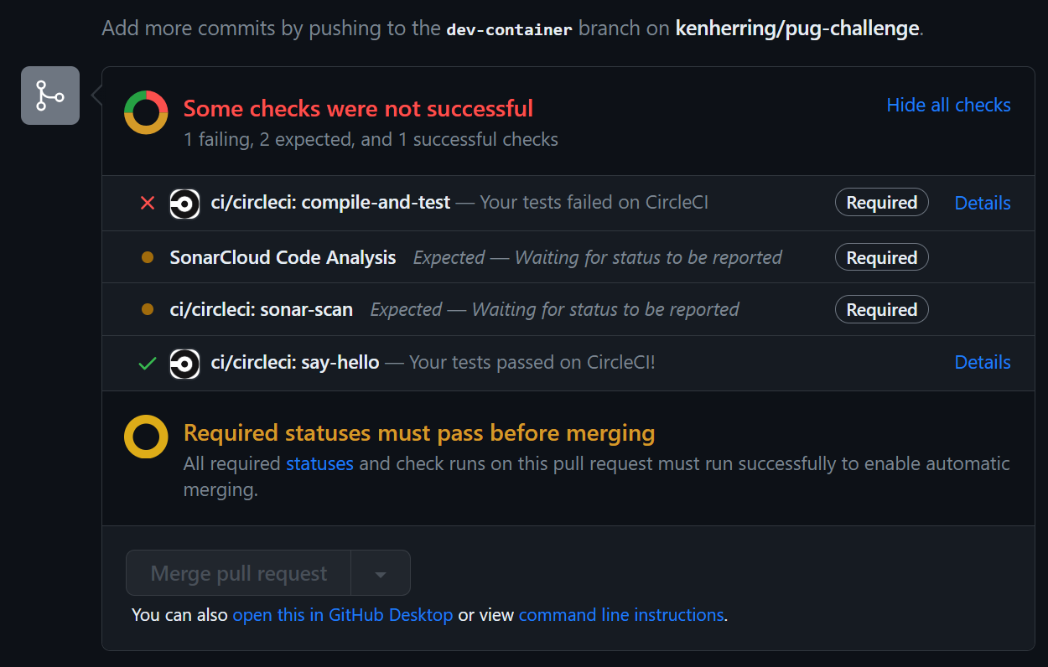
Build Pipelines – Quality Gates
Failed steps prevent bad code from entering the code base
Strive to incorporate tests for repeat issues
“Shift Left”

Slide 9




Build Pipelines
DEPLOY!

Slide 10
Tooling
IDE
VSCode
PDSOE
VI/Emacs/Procedure Editor
Source Control
GitHub
GitLab
SVN
Packet System
Build Runner
CircleCI
GitHub Actions
Jenkins
Azure DevOps
Source Analysis
SonarQube
Vulnerability Scanner
Snyk
CodeQL (GitHub)
Docker Scout
Deployment Tool
CircleCI
Kubectl
Terraform
Amazon CodeDeploy
Shell Scripts

Slide 11
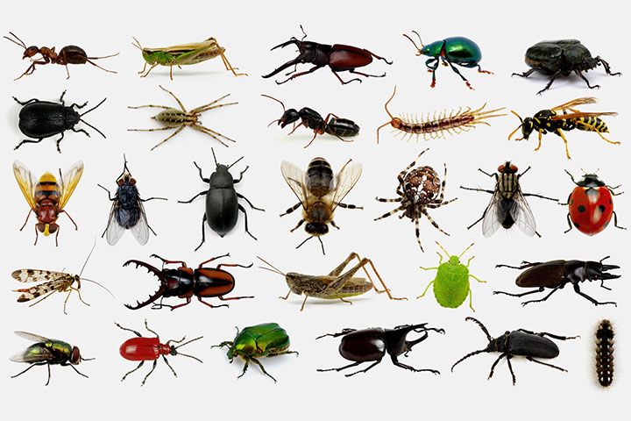
A day in the life…
Wake up
Meetings….
Write some code
Start testing…
More meetings...
Finish testing
Push code
Lunch
Pass code review
Merge

Slide 12

A day in the life… with pipelines
Wake up
Meetings….
Write some code
Start testing…
Push to GitHub
More meetings...
Finish testing
Clean up failures in build pipeline
Push code
Lunch
Pass code review
Faster because the reviewer didn’t have to check a million things
Merge
Deploy
But this time there was no bug!

Slide 13
Live Demo (plus Q&A)

Slide 14

Summary
Build pipelines are your best friend
Faster development
Less error-prone
“Shift Left” developer feedback
Gates/checks provide confidence

Slide 15
Thank You!
Questions?

